Slide 1
Windchill Work Group Manager SolidWorks CAD Data Management with Windchill PDMLink 10
By: Martin St-Laurent
Date: 29-03-2012

Slide 2
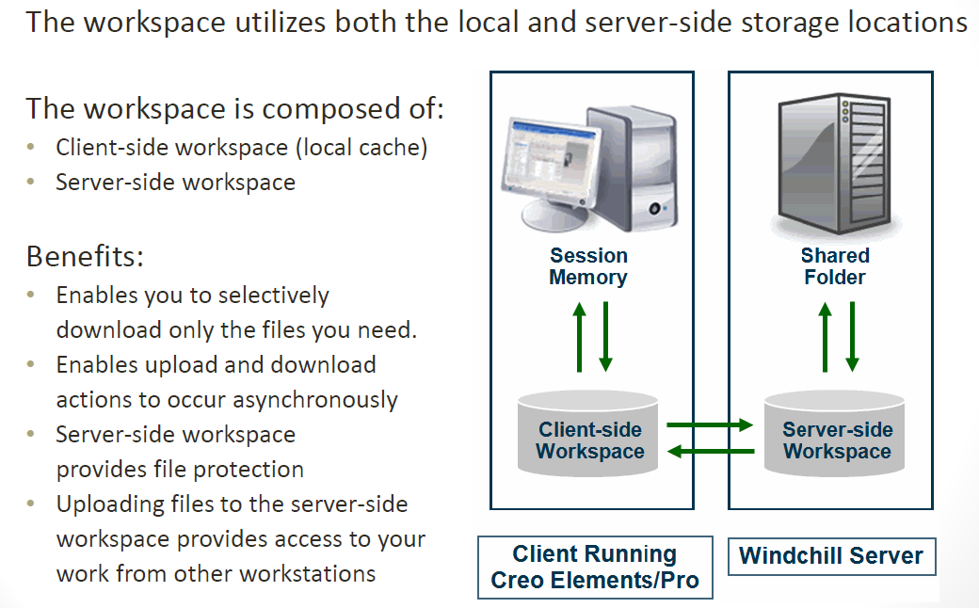
Understanding Workspace Architecture

Slide 3
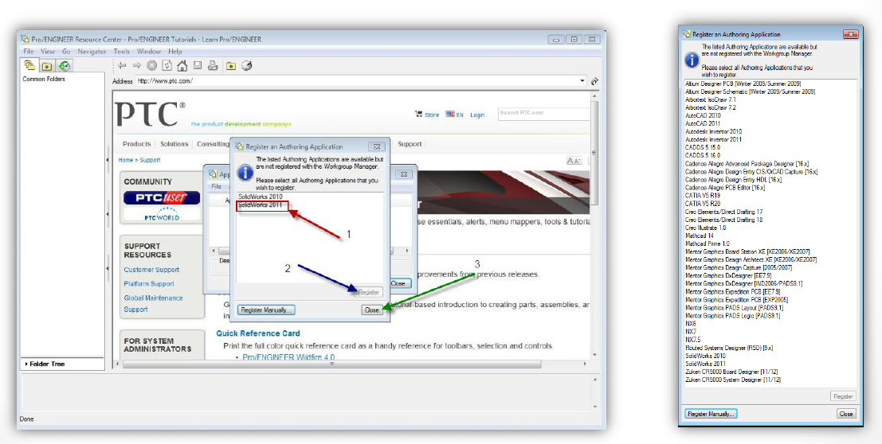
Register an Authoring Application
Select Solidworks 2014

Slide 4
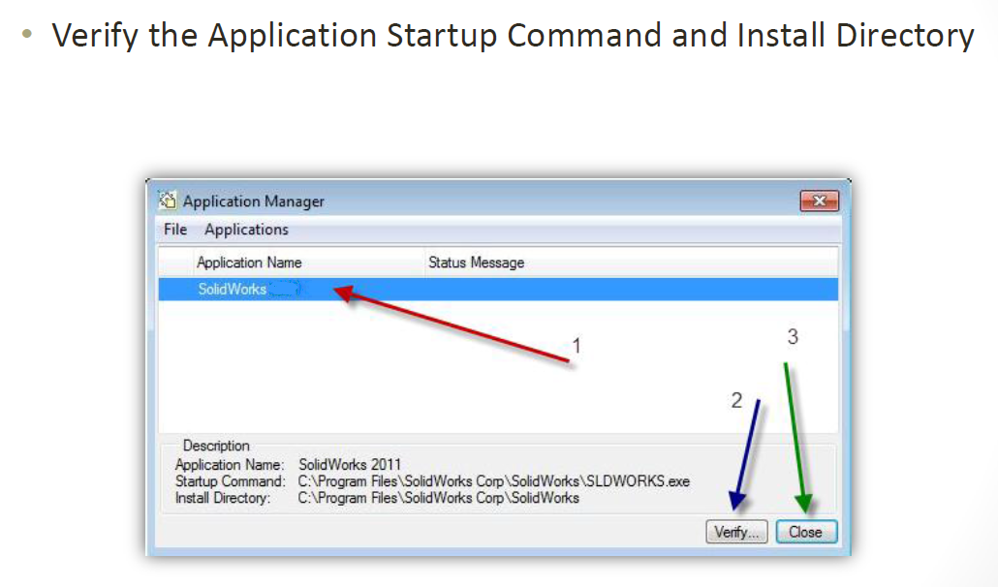
Register an Authoring Application

Slide 5
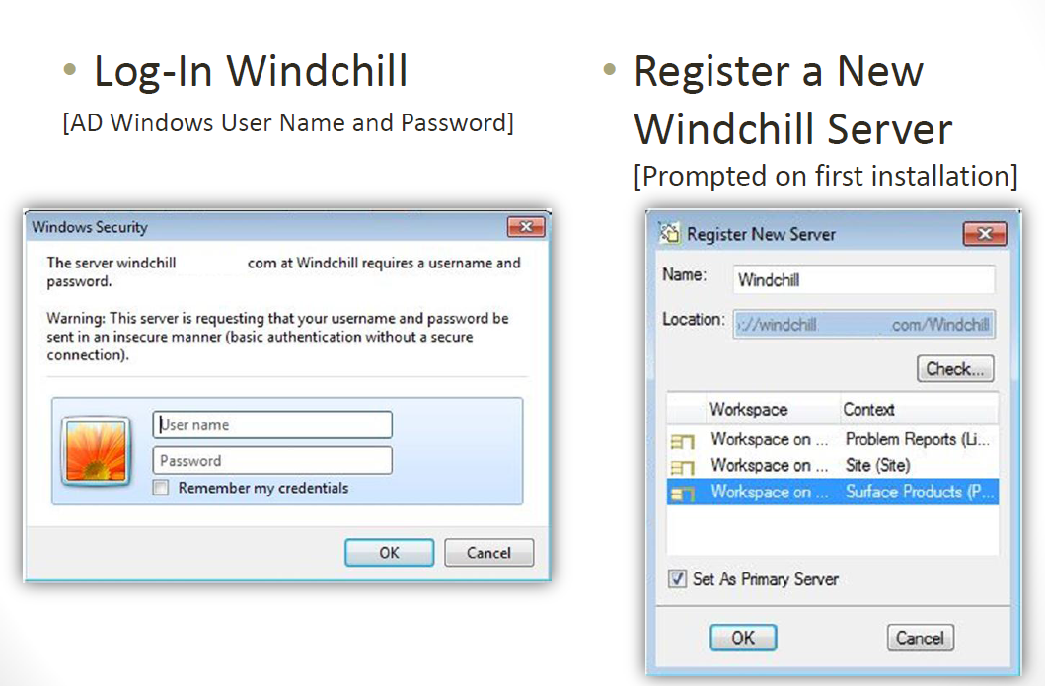
Windchill Integration

Slide 6
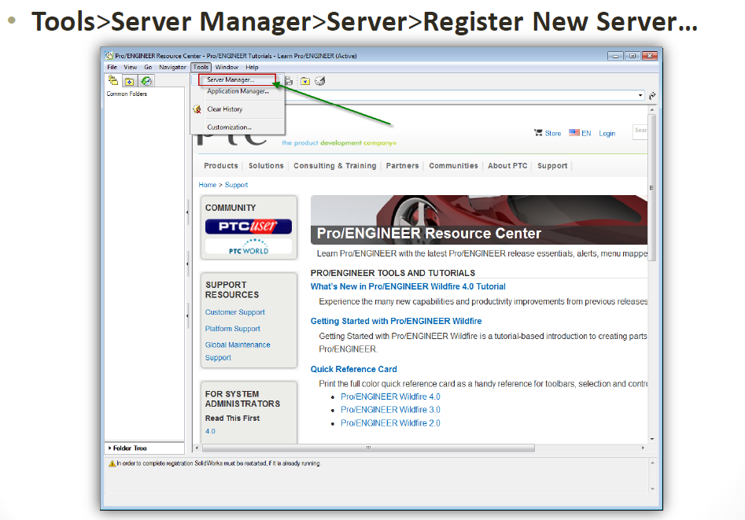
Windchill Integration

Slide 7
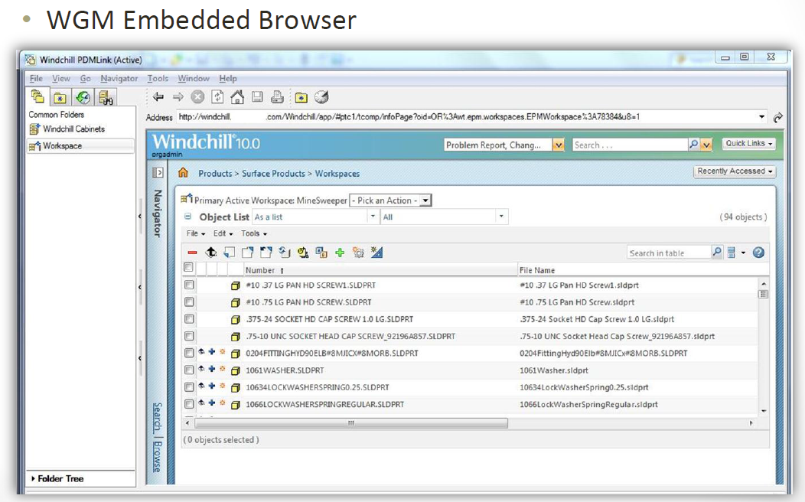
Identify Desired Content

Slide 8
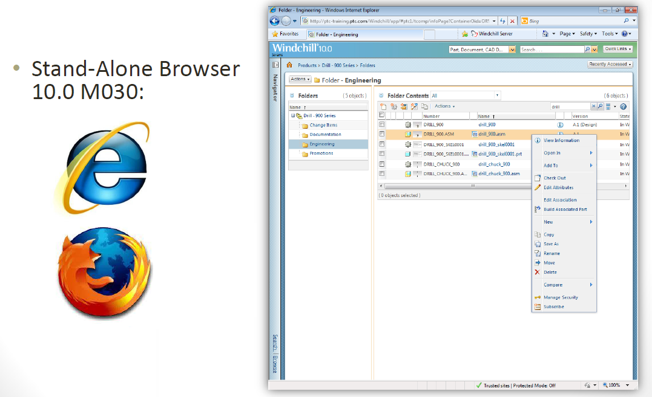
Identify Desired Content

Slide 9
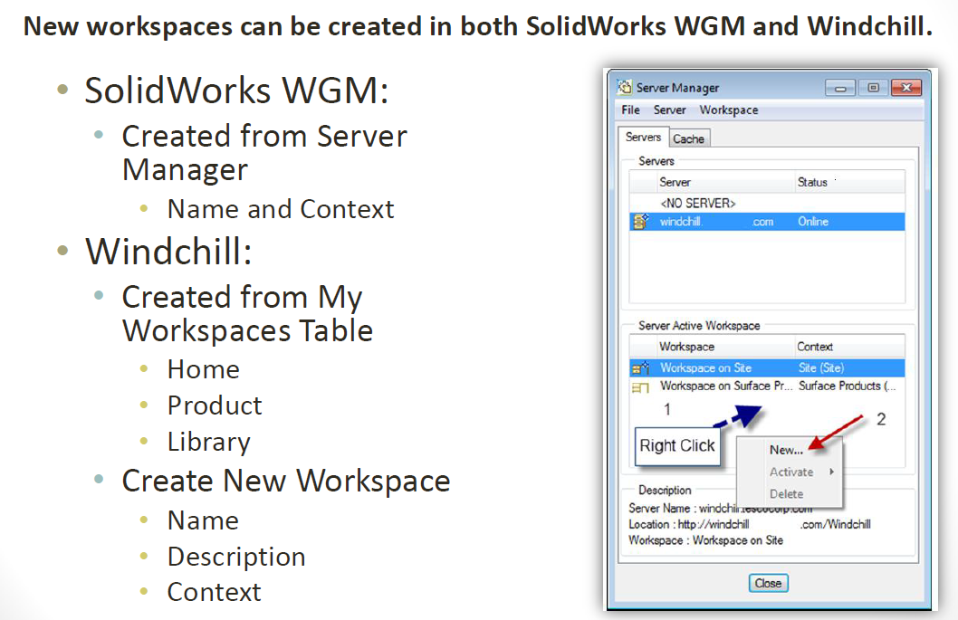
Creating Workspaces

Slide 10
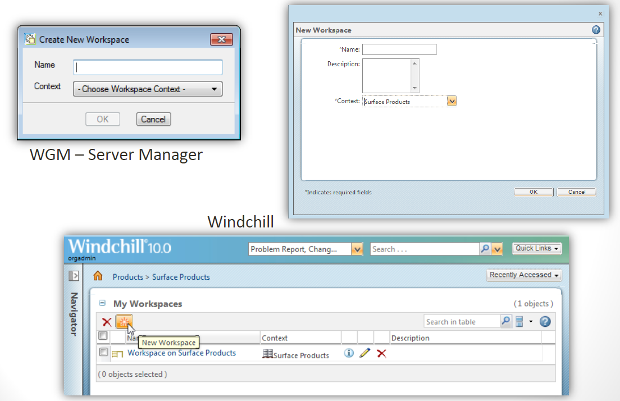
Creating Workspaces

Slide 11
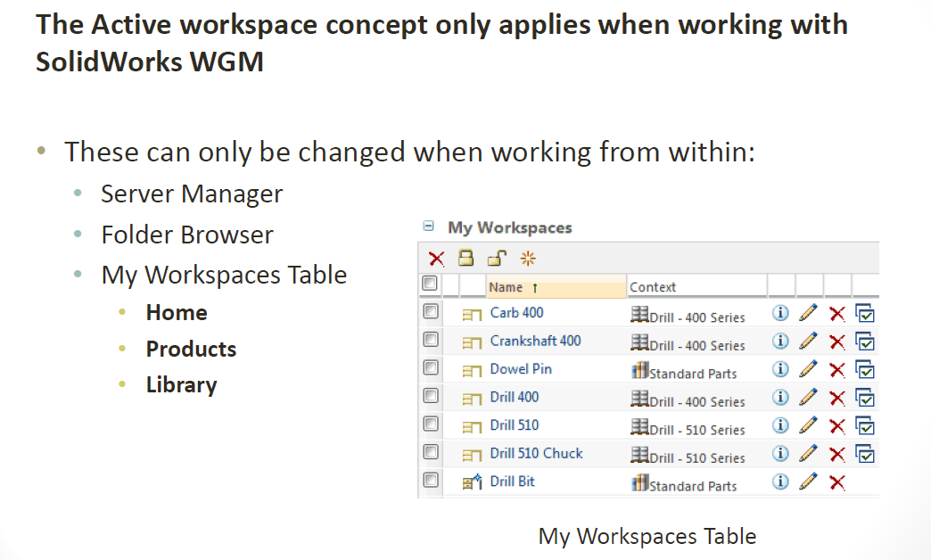
Changing the Active Workspace

Slide 12
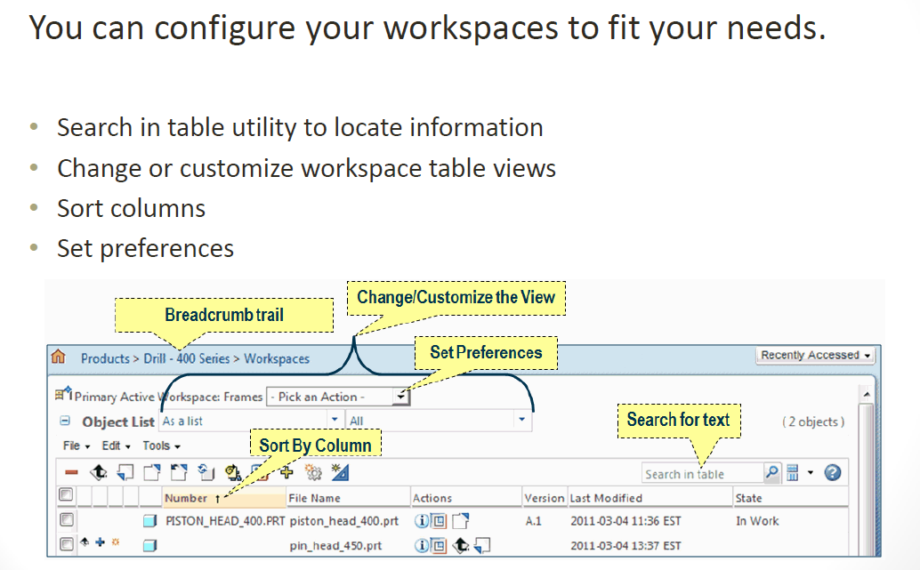
Working with Workspaces

Slide 13
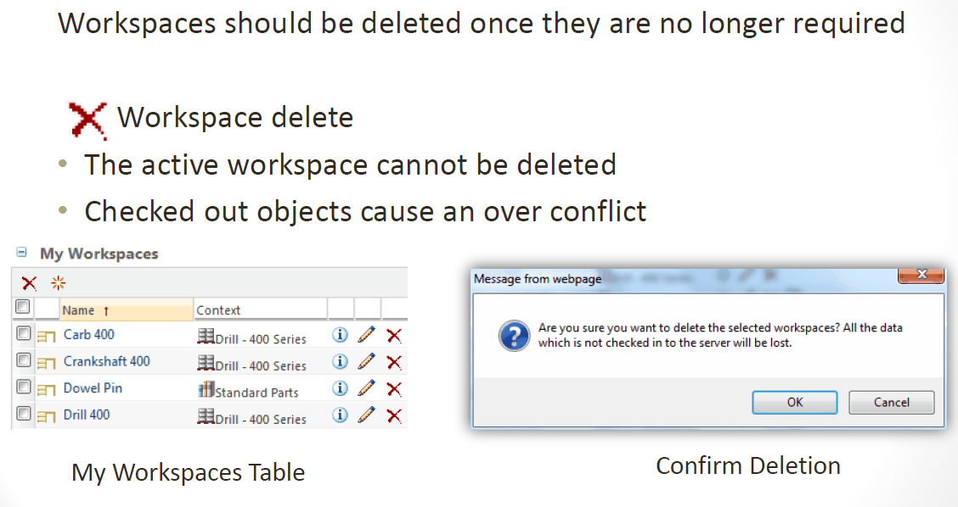
Deleting Workspaces

Slide 14
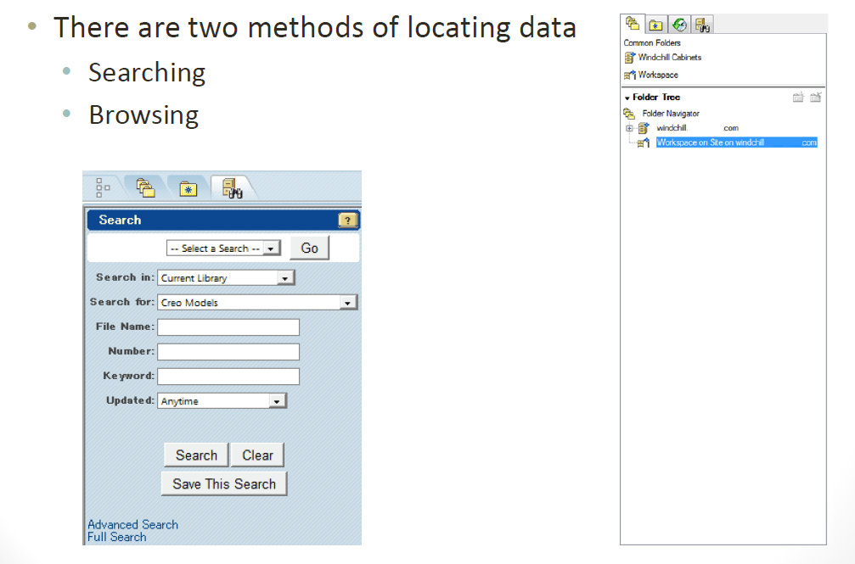
Locating Design Information with WGM

Slide 15
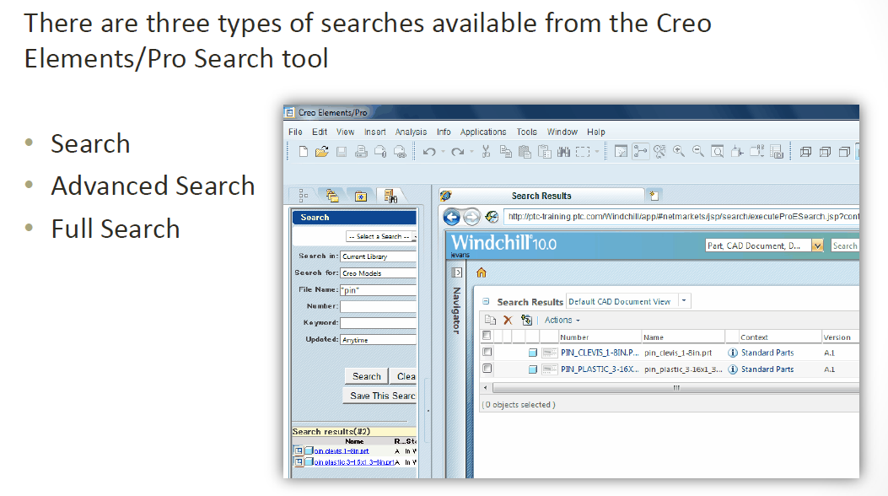
Searching for Design Information

Slide 16
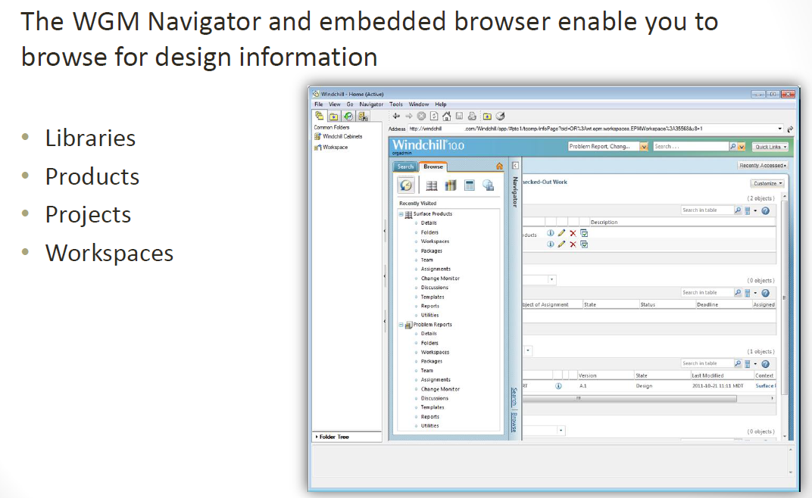
Browsing for Design Information

Slide 17
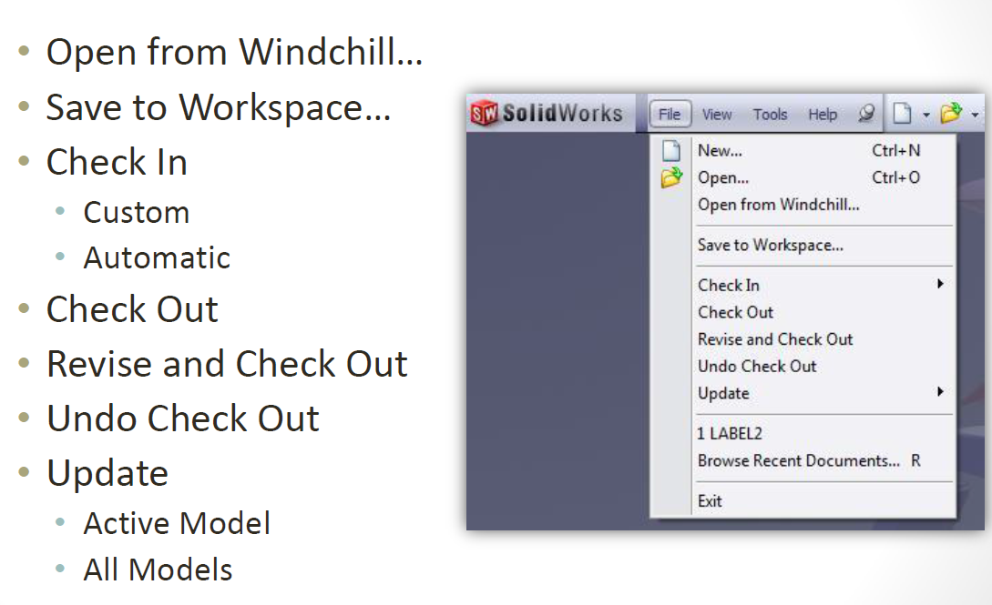
WGM Functionality in SolidWorks

Slide 18
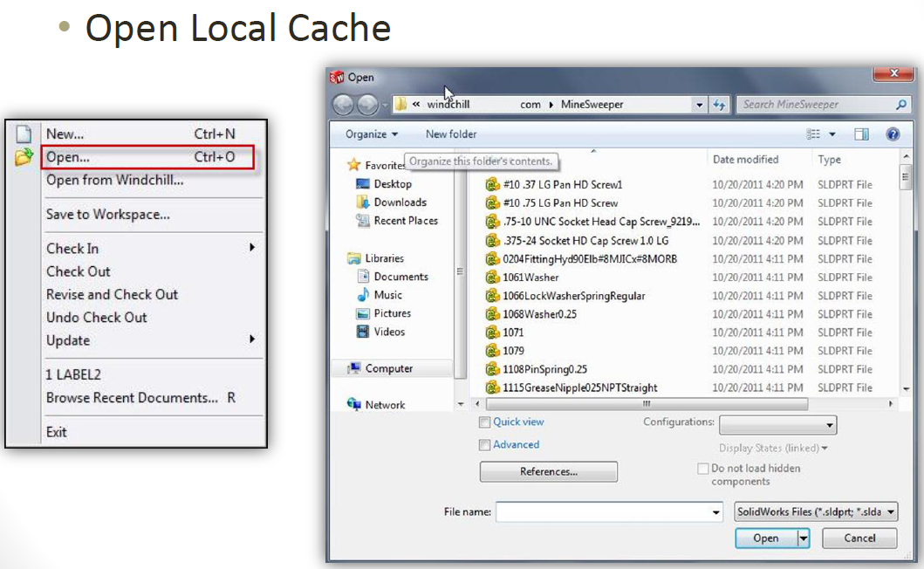
WGM Functionality in SolidWorks

Slide 19
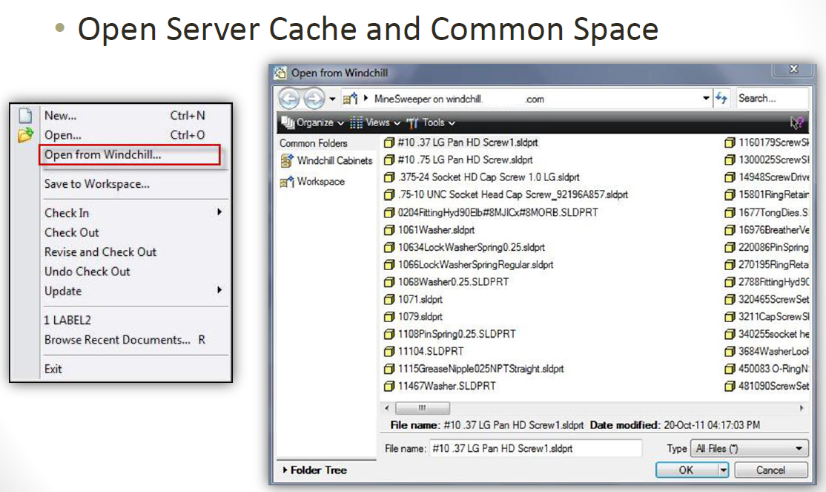
WGM Functionality in SolidWorks

Slide 20
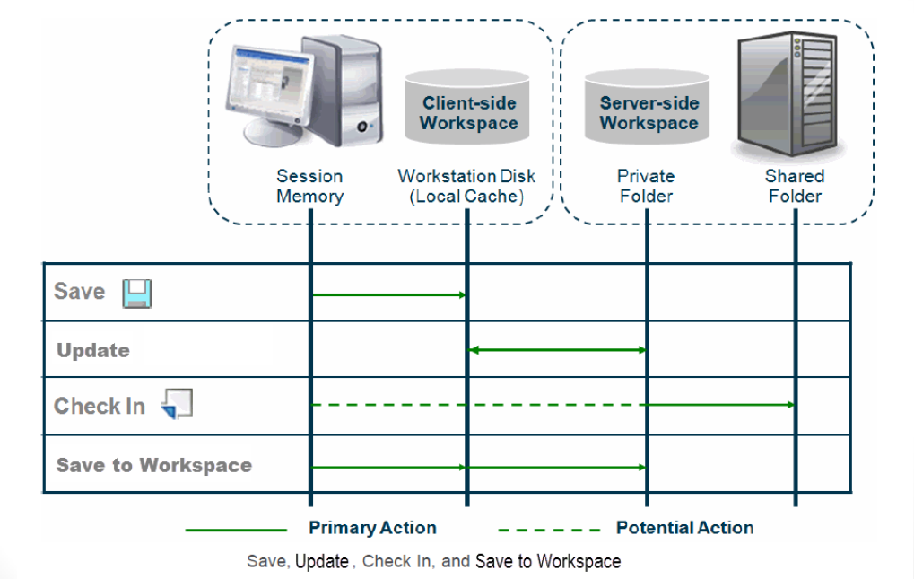
WGM Functionality in SolidWorks

Slide 21
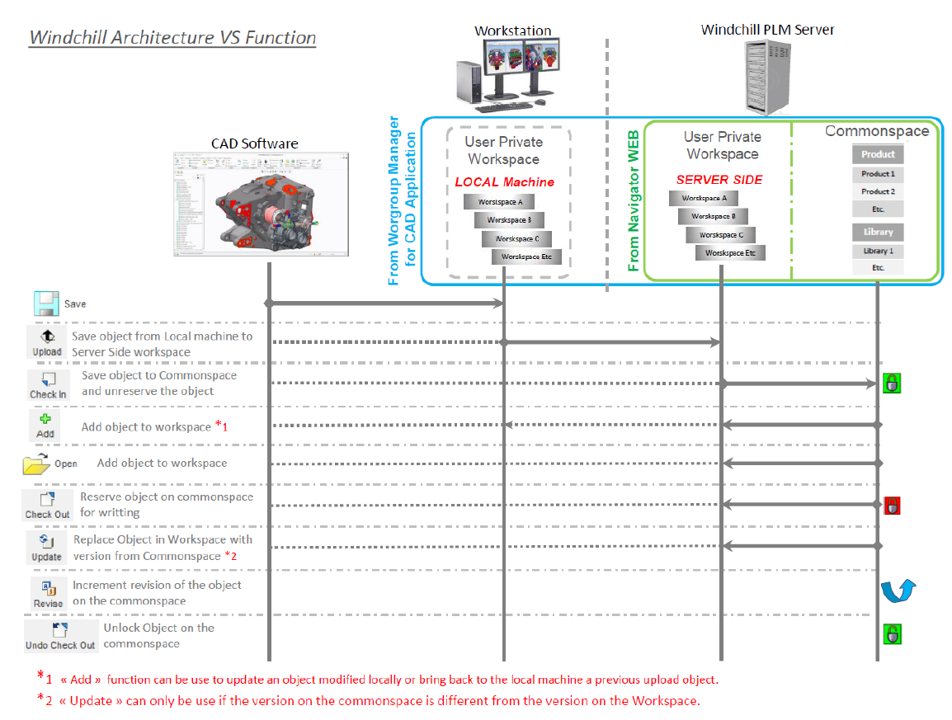
WGM Functionality in SolidWorks

Slide 22
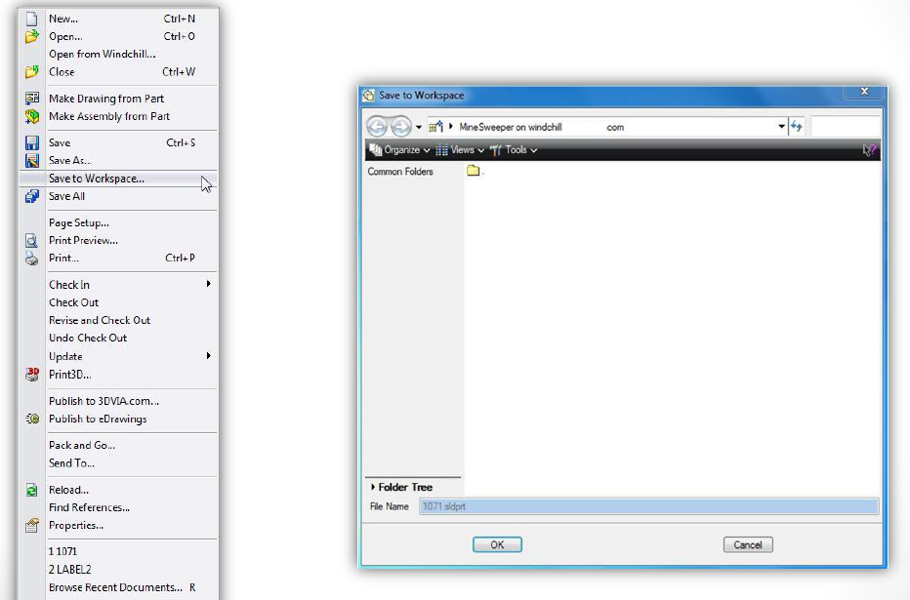
WGM Functionality in SolidWorks

Slide 23
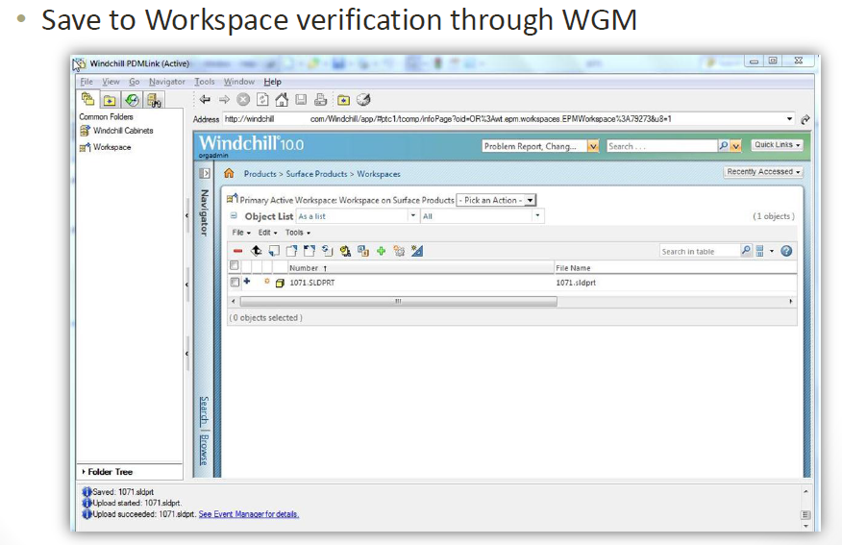
WGM Functionality in SolidWorks

Slide 24
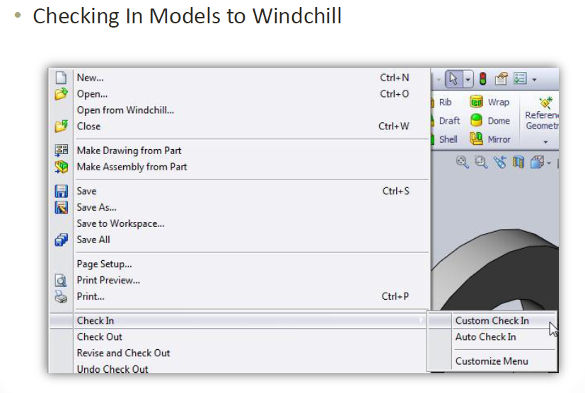
WGM Functionality in SolidWorks

Slide 25
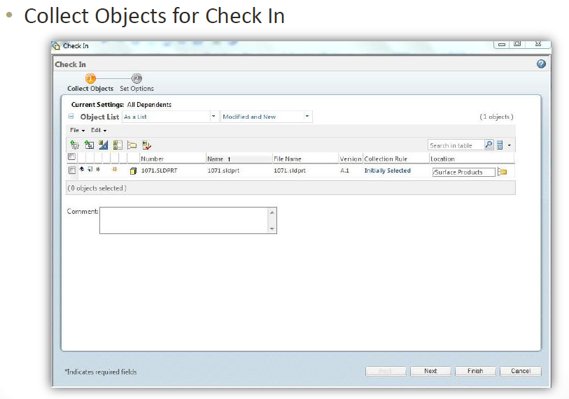
WGM Functionality in SolidWorks

Slide 26
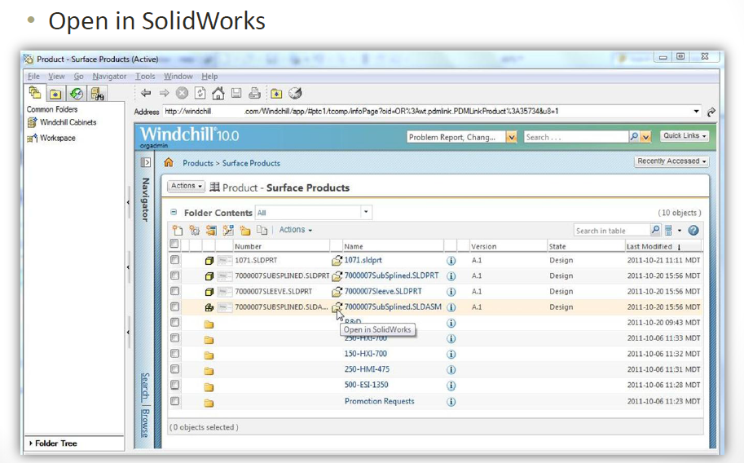
WGM Functionality in SolidWorks

Slide 27
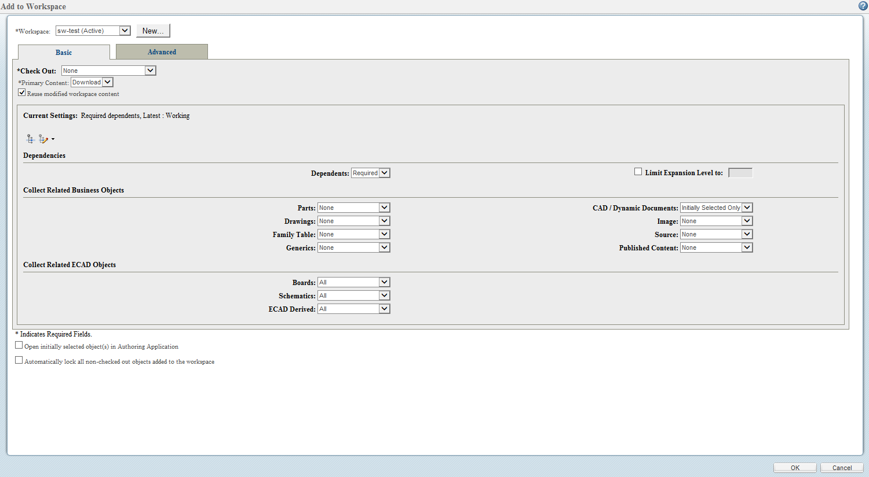
WGM Functionality in SolidWorks
Add To Workspace Collector(basic)

Slide 28
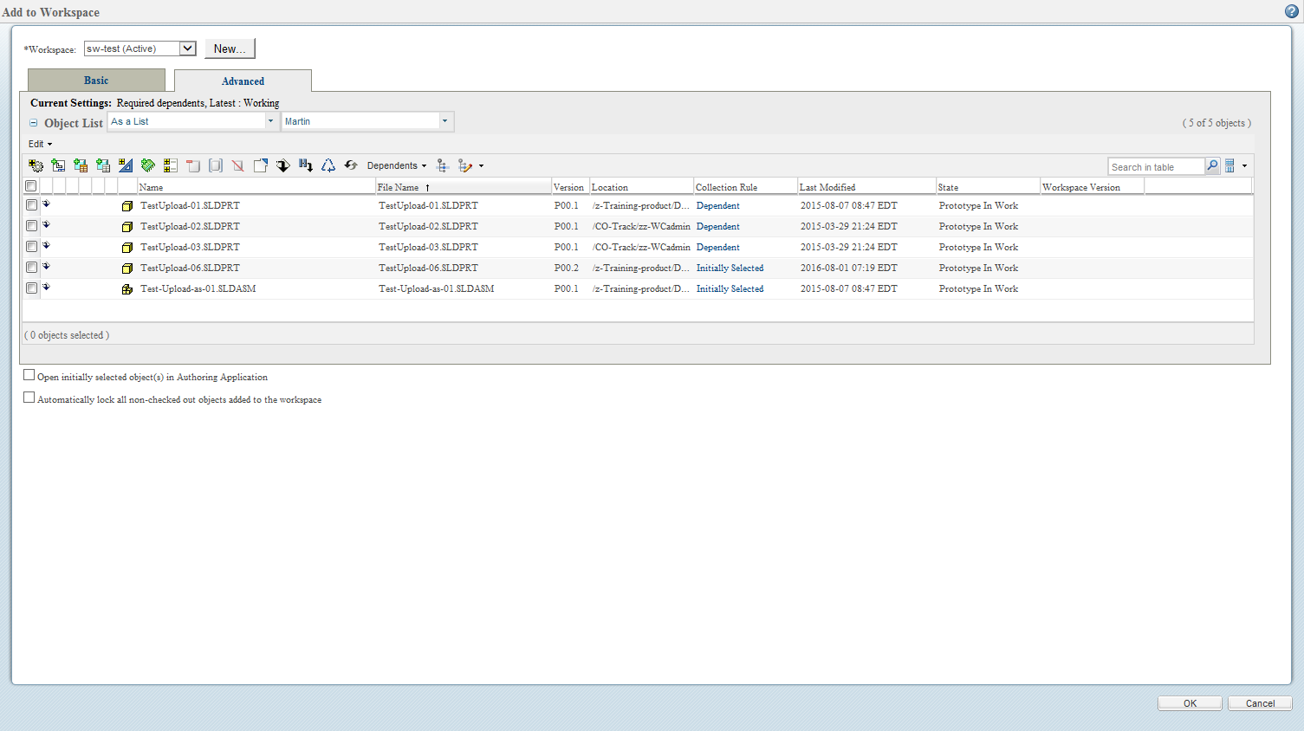
WGM Functionality in SolidWorks
Add To Workspace Collector (Advanced)

Slide 29
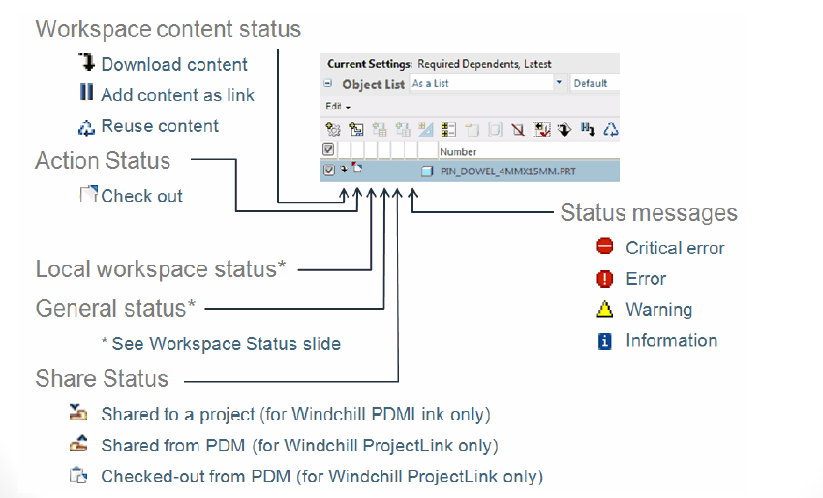
Workspace Status

Slide 30
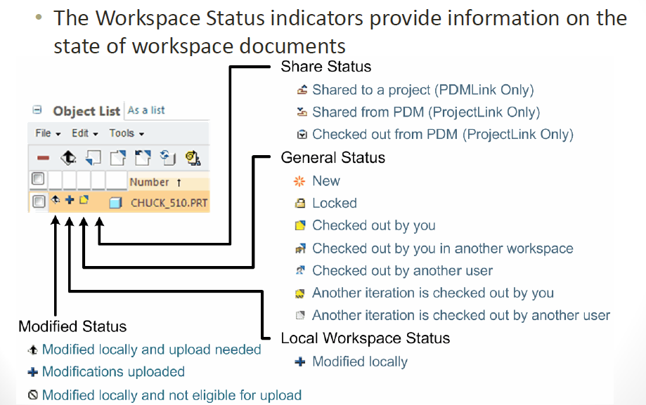
Workspace Status

Slide 31
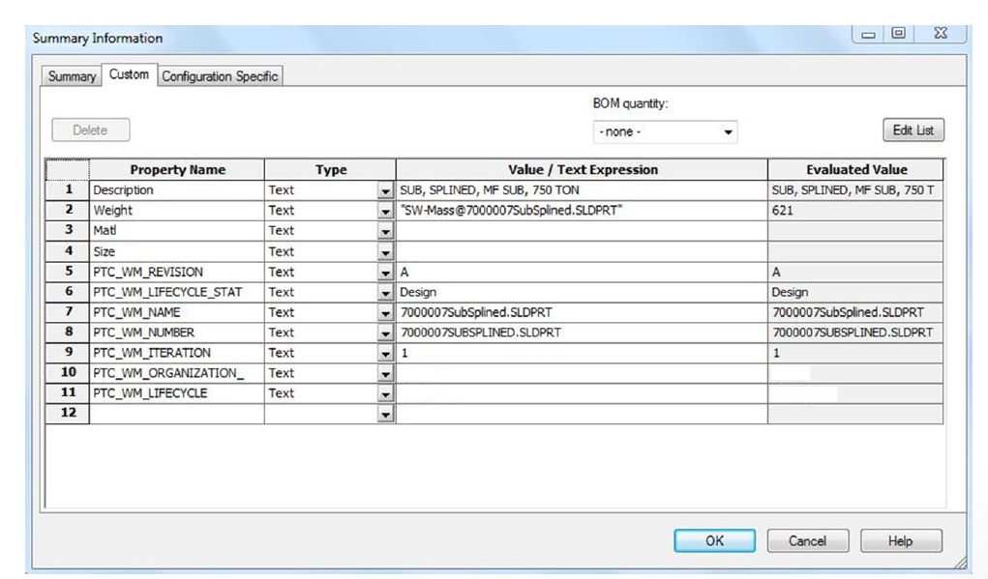
SolidWorks Properties

